Slide 1
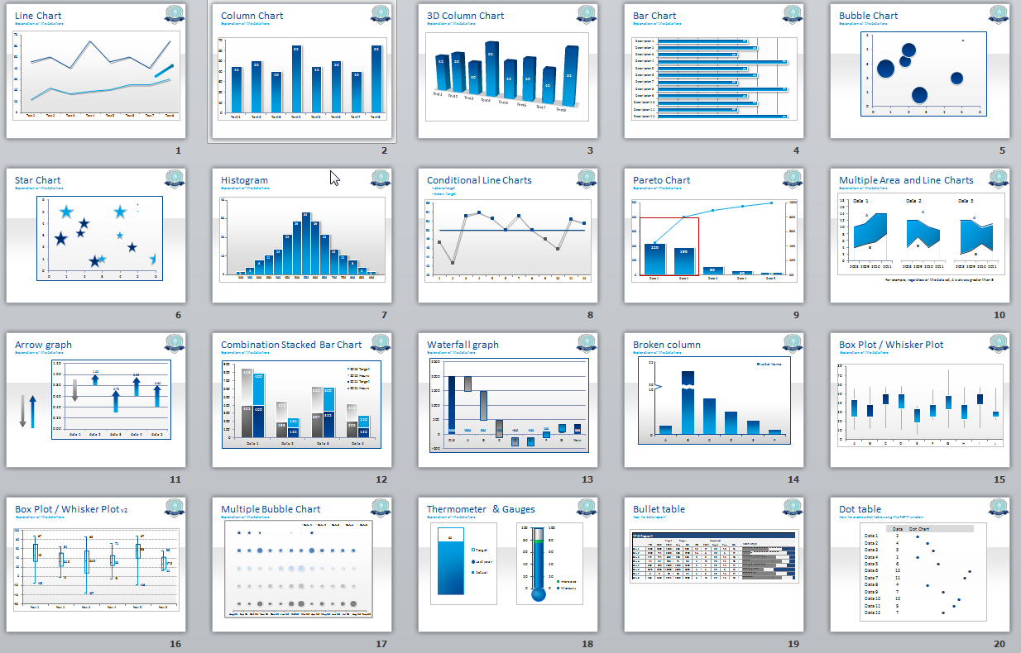
Graphics Practice2

Slide 2
Remember that questions may ask you just about the graph, or you may be asked to compare/contrast the graph with the accompanying text passage.

Slide 3
SAMPLE TEST QUESTIONS about GRAPHICS
ASKS JUST ABOUT THE GRAPH
ASKS READER to CONNECT TEXT PASSAGE and GRAPHICS

Slide 4
See next slide

Slide 5
TEXT EXCERPT:
Higher Interest Rates
The lower your credit score, the higher the interest rate you’ll pay on some forms of credit, such as a credit card. If you carry a balance on your cards and take years to pay them off, you can pay thousands of dollars of extra interest payments in the long term. Financial writer Liz Weston explains in an October 2011 MSN Money article how two women, the same age and with the same loans over the course of their lives, end up with a difference of more than $200,000 in interest payments based on their credit scores.
Loan Denials
Bad credit also affects your ability to secure a mortgage, car loan, credit card or other loans. You might be able to secure a credit card or a loan, not only can your interest rate be higher, but your loan amount also might be less than what you need or your lender might require a higher down payment. If you are applying for a business loan and are denied, you lose both the loan and the profits you might have earned if you'd had the opportunity to start your business.

Slide 6
Tweet/NYTimes graph directions:
In groups of 2, you will email me:
Construct one question about just the graph. Include 4 answer choices and explain which answer is correct/why.
Construct one question that asks the reader to compare/contrast the chart with the article excerpt. Include 4 answer choices and explain which answer is correct/why.

